Slide 1


Introduction to Python – Week 5
Mark Smith

Slide 2
Course outline
Lesson 1 – Getting Started: Introduction and Arithmetic Operators
Lesson 2 – Types and Variables
Lesson 3 – Functions
Lesson 4 – Conditional Statements
Lesson 5 – Further Conditionals and Recursion
Lesson 6 – Strings
Lesson 7 – Lists
Lesson 8 – Dictionaries
Lesson 9 – Tuples
Lesson 10 – Project

Slide 3
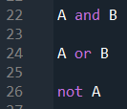
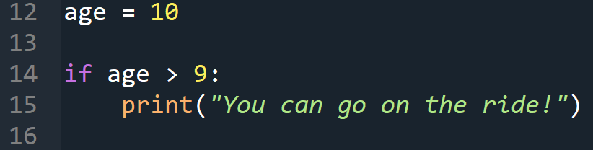
Last Week
Code
x == y
x != y
x > y
x < y
x >= y
x <= y
What are Relational Operators
What are Logical Operators
How do we use Conditional statements

Slide 4
This Week – further conditionals and recursion
Today we will learn:
What are alternative conditionals?
What are chained conditionals?
What are nested conditionals?
What are recursive functions?

Slide 5
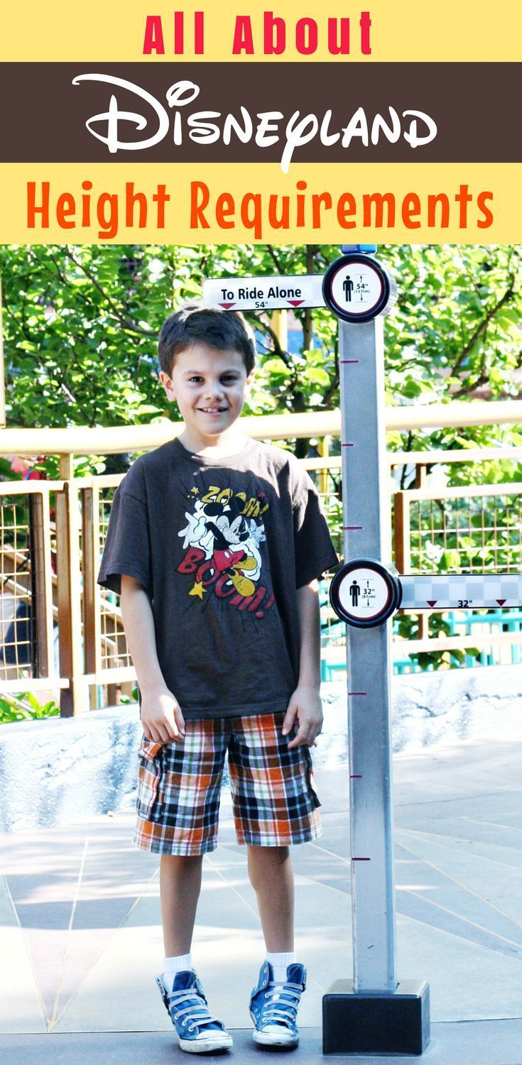
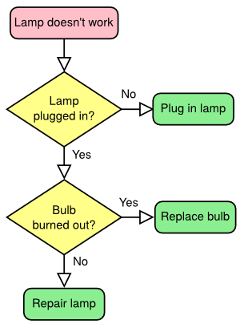

What is a conditional statement?
Last Week
A conditional statement in Python is one that checks a condition before deciding whether or not to run a piece of code.

Slide 6
Writing conditional statements
Last Week
Now, we can define conditional statements as follows,
The way we define a conditional statement looks very similar to the way we defined something else… What is that?

Slide 7
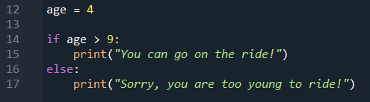
Alternative Execution
Last week, we saw conditional statements that test for a condition. Now what if we want something to happen if the main condition is not satisfied?
For Example, if the age of the rider is less than 9, we want to print “Sorry, you are too young to ride!”

Slide 8
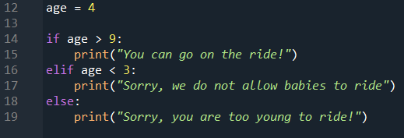
Chained conditional
What if we want to check more than one condition?
We can use the elif keyword that allows us to chain conditional statements
When does the else condition run?
3 <= age <= 9

Slide 9
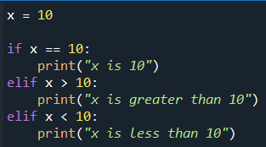
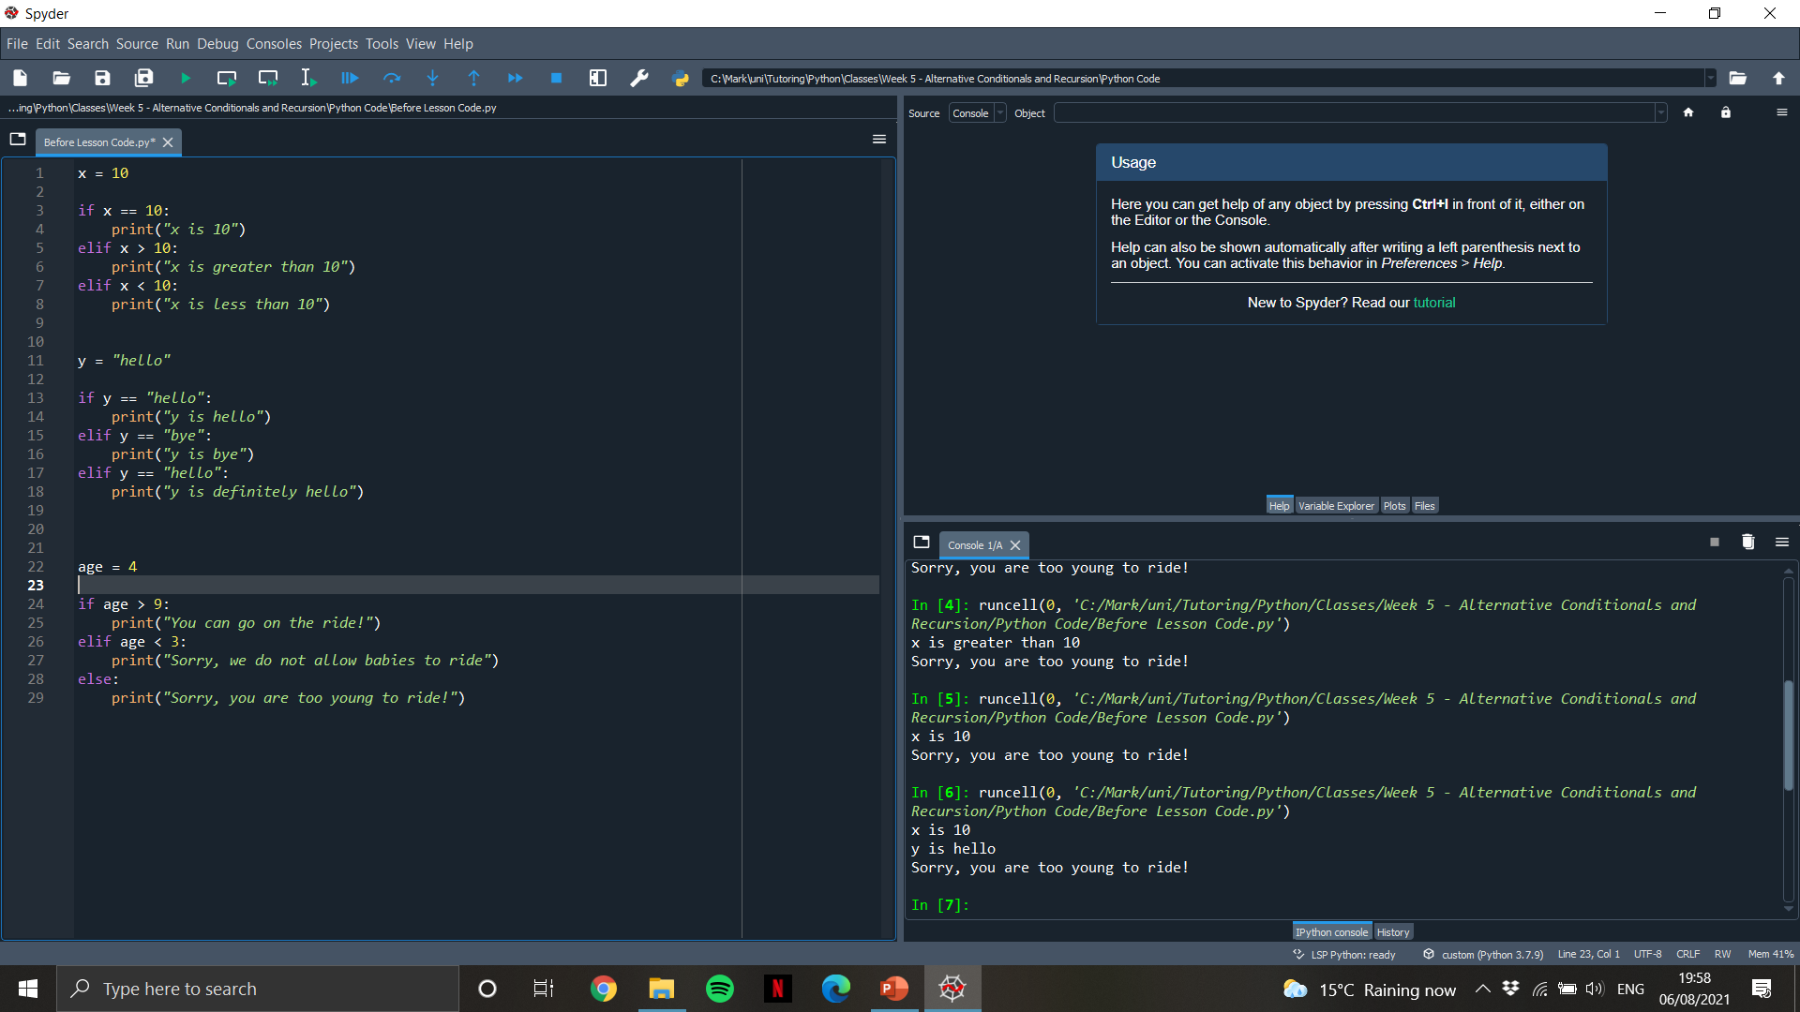
Chained conditional rules
We do not need an else statement
The statements are checked in order and only one runs

Slide 10
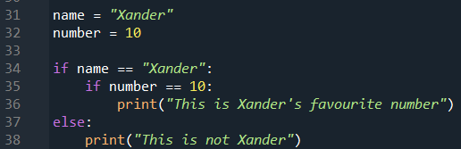
Nested conditionals
We can place conditional statements inside other conditional statements.
Imagine that we wanted to check if a number is bigger than 10 and a name is “Xander”

Slide 11
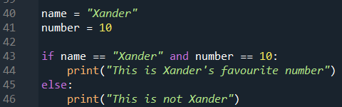
Nested conditionals 2
Instead of using nested conditionals, we can use the logical operators that we saw last week

Slide 12
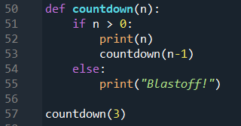
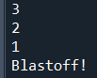
Recursive functions
We saw previously that functions can call other functions. Now, we see that functions can call themselves and act recursively

Slide 13
Recursive functions
We saw previously that functions can call other functions. Now, we see that functions can call themselves and act recursively
__main__
countdown
n = 3
countdown
n = 2
countdown
n = 1
countdown
n = 0

Slide 14
End of class
This week we have looked at:
What are Relational Operators
What are Conditional Operators
How do we use Conditional statements

